Slide 1

Advanced Topics in Economic Evaluation and Healthcare
Lecture #1: An Introduction to Economic Evaluation in Healthcare

Slide 2
About this Course
The objective of this course is to provide students an introduction to decision analytic methods used in economic evaluation of health care implementation.
Decision analysis refers to the field of study that examines how decision makers should make the best choices under uncertainty.
Economic Evaluation refers to the act of valuing and ranking outcomes for the purpose of allocating scarce resources.
The goal of this course is to teach you how to model utilization of novel medical treatments and compute key statistics which answer the following questions:
“Does this medical treatment generate value for money or not”

Slide 3
An Overview of Economic Evaluation

Slide 4
What is Economic Evaluation
Economic evaluation is the process of systematic identification, measurement and valuation of the inputs and outcomes of two alternative activities, and the subsequent comparative analysis of these.
-Drummond, Michael; Sculpher, Mark; Torrance, George; O'Brien, Bernie; Stoddart, Greg (2005). Methods for the Economic Evaluation of Health Care Programmes (3 ed.)
In the context of health, economic evaluation is used to determine if it makes sense to pay for or fund new drugs and medical technologies.
Because of this, economic evaluation has played a role in both assessing the value of new medical technologies and marketing them.

Slide 5
Economic Evaluation and The Life Cycle of a Drug
Price
Clinical Trials Phase I
Registration
Pharmacology
Phase II
Drug surveillance
Chronical toxicity
Acute Toxicology
Phase III
Patent filed
Discovery
Patent Expires
Time
Research
10 years
Administration
20 years
15 years

Slide 6
Economic Evaluation and The Life Cycle of a Drug
Health Economists Work
Here!
Price
Clinical Trials Phase I
Registration
Pharmacology
Phase II
Drug surveillance
Chronical toxicity
Acute Toxicology
Phase III
Patent filed
Discovery
Patent Expires
Time
Research
10 years
Administration
20 years
15 years

Slide 7
Who does Economic Evaluation?
Economic Evaluation is often used to tell a story of if a drug is cost effective. Meaning: “does this new drug more effective and/or cheaper than current treatments on the market”.
Often Drug R&D firms will submit Economic Evaluations to governments or 3rd party payers (i.e. insurance companies) when applying for funding.
Because of this “marketing” aspect of economic evaluation assessors must carefully review submitted results and model structures to see if their assessment is accurate.
Still, a large majority of economic evaluation work is done by independent researchers.

Slide 8
Economics and Economic Evaluation
Terminology

Slide 9
What is Economics?
Economics studies the allocation of scarce resources under conditions of scarcity.
  Microeconomics is the subfield which analyzes how consumer and firms behave and how they interact in a single market, determining prices and quantities transacted.
  Macroeconomics is the subfield which analyzes the whole economy focusing on economy wide productivity through GDP, Inflation and Unemployment.
Economic evaluation is a subfield of Microeconomics, in particular its focus is on how decision makers should choose between two or more options.
This course is about economic evaluation in health, so we are looking at a subfield of a subfield within economics as a whole.

Slide 10
A Conceptual Map of the Field of Economics
Macroeconomics
Microeconomics
Health Economics
Economic Evaluation

Slide 11
A Conceptual Map of the Field of Economics
Macroeconomics
Microeconomics
What this course is about
Health Economics
Economic Evaluation

Slide 12
Key Concepts in Economics
There are several concepts from economics which we will serve as the conceptual basis for this course.
  Scarcity
  Opportunity Cost
  Marginal Analysis
Over the next couple of slides we will explore each of these conceptually.

Slide 13
Scarcity
Economics is based on the premise of scarcity.
  There are limited resources (time for a doctor, medical equipment or number of beds in an emergency room).
  But Unlimited wants (unlimited needs of patients)
In the face of limited or scarce resources, we’re interested in how decision makers in healthcare make decisions on how to allocate resources.
  Which technologies are adopted?
  Which patient groups are prioritized?
  What set of conditions does a hospital or clinic service?
When making these decisions hospital are constrained by their budgets and current technologies. As such the task of dealing with scarcity has broadly been the main focus of economists.

Slide 14
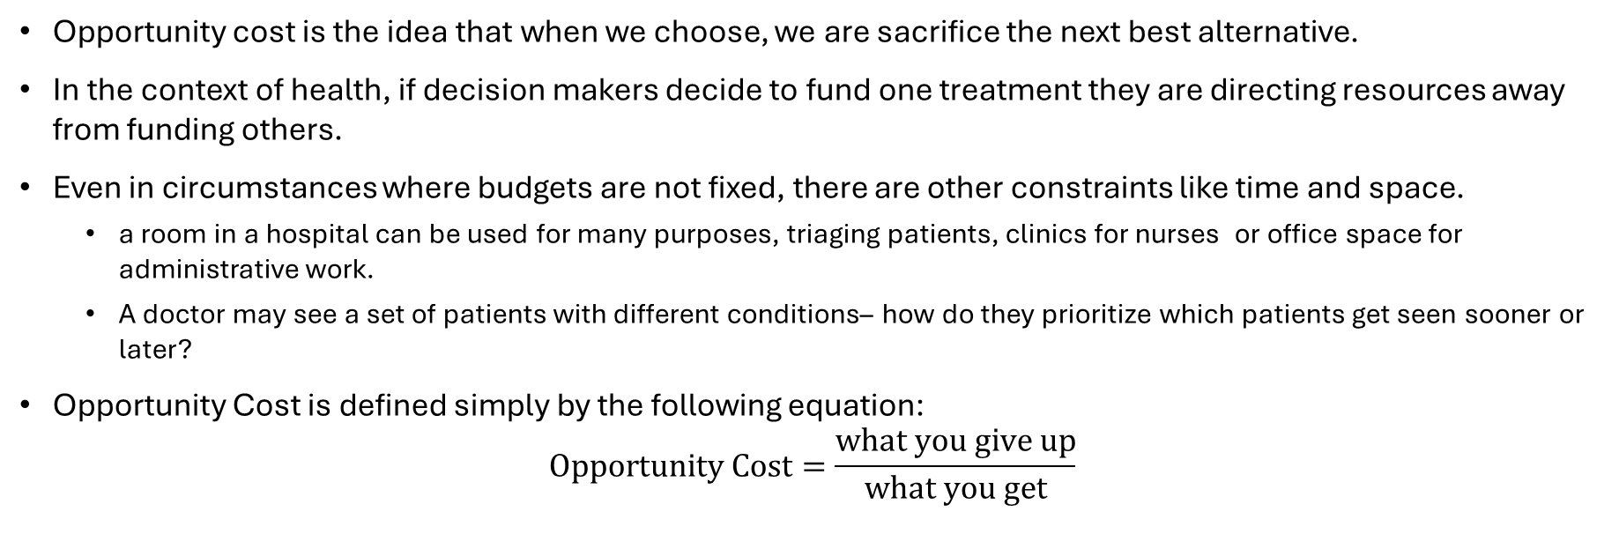
Opportunity Cost
Opportunity cost is the idea that when we choose, we are sacrifice the next best alternative.
In the context of health, if decision makers decide to fund one treatment they are directing resources away from funding others.
Even in circumstances where budgets are not fixed, there are other constraints like time and space.
  a room in a hospital can be used for many purposes, triaging patients, clinics for nurses or office space for administrative work.
  A doctor may see a set of patients with different conditions– how do they prioritize which patients get seen sooner or later?
Opportunity Cost is defined simply by the following equation:
$Opportunity Cost=\frac{what you give up}{what you get}$

Slide 15
A First Economic Model: The Budget
We can model the tradeoffs faced by a hospital budget holder as follows.
A hospital has 10 million dollars to invest in two different machines MRIs and X-Rays.
Suppose MRIs cost 2.5 million Dollars while X-Rays machines cost 0.5 Million Dollars.
MRI Machines
X- Rays

Slide 16
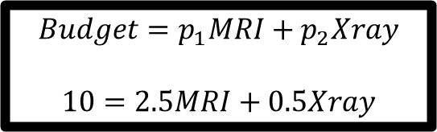
A First Economic Model: The Budget
We can model the tradeoffs faced by a hospital budget holder as follows.
A hospital has 10 million dollars to invest in two different machines MRIs and X-Rays.
Suppose MRIs cost 2.5 million Dollars while X-Rays machines cost 0.5 Million Dollars.
MRI Machines
$$Budget=p_{1}MRI+p_{2}Xray$$
$$10=2.5MRI+0.5Xray$$
X- Rays

Slide 17
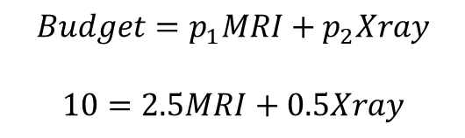
A First Economic Model: The Budget
We can model the tradeoffs faced by a hospital budget holder as follows.
A hospital has 10 million dollars to invest in two different machines MRIs and X-Rays.
Suppose MRIs cost 2.5 million Dollars while X-Rays machines cost 0.5 Million Dollars.
MRI Machines
$$Budget=p_{1}MRI+p_{2}Xray$$
$$10=2.5MRI+0.5Xray$$
Unfeasible
Feasible
X- Rays

Slide 18
A First Economic Model: The Budget
We can model the tradeoffs faced by a hospital budget holder as follows.
A hospital has 10 million dollars to invest in two different machines MRIs and X-Rays.
Suppose MRIs cost 2.5 million Dollars while X-Rays machines cost 0.5 Million Dollars.
Question 1: what is the maximum Number of
MRIs and X-Rays which can be purchased?
Question 2: What is the Opportunity cost of MRIs? (and conversely what is the opportunity cost of X-Rays?)
MRI Machines
$$Budget=p_{1}MRI+p_{2}Xray$$
$$10=2.5MRI+0.5Xray$$
X- Rays

Slide 19
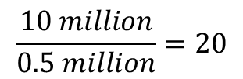
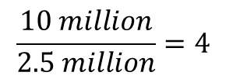

A First Economic Model: The Budget
We can model the tradeoffs faced by a hospital budget holder as follows.
A hospital has 10 million dollars to invest in two different machines MRIs and X-Rays.
Suppose MRIs cost 2.5 million Dollars while X-Rays machines cost 0.5 Million Dollars.
Question 1: what is the maximum Number of
MRIs and X-Rays which can be purchased?
Question 2: What is the Opportunity cost of X-Rays? (and conversely what is the opportunity cost of MRIs?)
MRI Machines
$$\frac{10 million}{2.5 million}=4$$
X-Ray OC$=\frac{2.5 million/MRI}{0.5 million/xray}=5$ $\frac{xray}{MRI}$
$$\frac{10 million}{0.5 million}=20$$
X- Rays

Slide 20
Marginal Analysis
Concepts of Scarcity and Opportunity cost tell us features of the environment of choice.
  Resources are scarce
  Decisions involve tradeoffs
But so far we have not discussed how to choose or how much to choose.
Decision Makers are interested in maximizing their benefits while minimizing their costs.

Slide 21
Marginal Analysis
The way this is done is by thinking in terms of the Marginal Benefit per Unit VS the Marginal Cost per Unit of some good.
In general, benefits experience diminishing returns which means that while benefits do increase in the consumption of a particular good they are less so as they are increased.
  Example 1: The Initial Enjoyment a hungry person receives from one slice of pizza is large, but the second slice while still good is not as enjoyable.
  Example 2: Everyone made a decision about how many covid 19 vaccines booster they would take (even in 2026, they are still suggested) as we see, most people have not been continuously vaccinating.

Slide 22
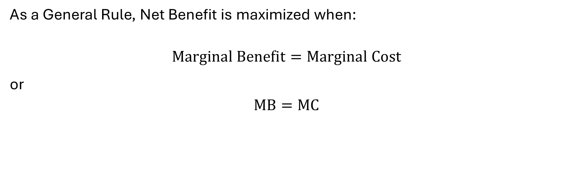
Marginal Analysis
As a General Rule, Net Benefit is maximized when:
$$Marginal Benefit=Marginal Cost$$
or
$$MB=MC$$

Slide 23
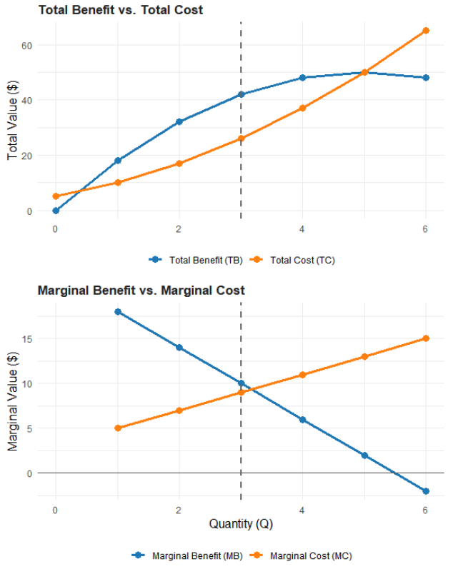
A Graphic Example of Marginal Analysis
Quantity (Q) | Total Benefit (TB) | Marginal Benefit (MB) | Total Cost (TC) | Marginal Cost (MC) | Net Benefit (TB−TC)
0 | 0 | — | 5 | — | -5
1 | 18 | 18 | 10 | 5 | 8
2 | 32 | 14 | 17 | 7 | 15
3 | 42 | 10 | 26 | 9 | 16
4 | 48 | 6 | 37 | 11 | 11
5 | 50 | 2 | 50 | 13 | 0
6 | 48 | -2 | 65 | 15 | -17

Slide 24
A Graphic Example of Marginal Analysis
Quantity (Q) | Total Benefit (TB) | Marginal Benefit (MB) | Total Cost (TC) | Marginal Cost (MC) | Net Benefit (TB−TC)
0 | 0 | — | 5 | — | -5
1 | 18 | 18 | 10 | 5 | 8
2 | 32 | 14 | 17 | 7 | 15
3 | 42 | 10 | 26 | 9 | 16 (Max)
4 | 48 | 6 | 37 | 11 | 11
5 | 50 | 2 | 50 | 13 | 0
6 | 48 | -2 | 65 | 15 | -17
Net Benefit is Largest Here

Slide 25
The foundations of economic evaluation
Economic evaluation is grounded in well defined concepts in economics such as scarcity, opportunity cost and Marginal Analysis.
The challenges in health care is that we are determining the value for money a treatment.
This becomes complex because while Costs are relatively well defined (i.e. dollar amounts) Benefits are not.
This thus creates three different approaches to economic evaluation
  Cost Benefit Analysis.
  Cost Effectiveness Analysis.
  Cost Utility Analysis.
Each of these will be discussed in depth in the following slides.

Slide 26
Types of Analysis: CMA, CEA, CUA and CBA.

Slide 27
Analysis type
The purpose of economic evaluation and health technology assessment is to determine if the adoption of new technology (or the continued funding of older technology which is already in place) is efficient.
There are several ways of doing this:
  Demonstrating a cheaper alternative which produces the same patient outcomes (Cost Minimization Analysis).
  Demonstrate a new treatment is more effective and less costly in reaching some clinically relevant target-lower blood pressure, stress, heart attack risk (Cost Effectiveness Analysis).
  Demonstrate a new treatment produces a higher quality of life at a lower cost compared to other treatments (Cost Utility Analysis).
  Demonstrate a new treatment produces a “dollar valued” quality of life at a lower cost compared to other treatments (Cost Benefit Analysis).

Slide 28
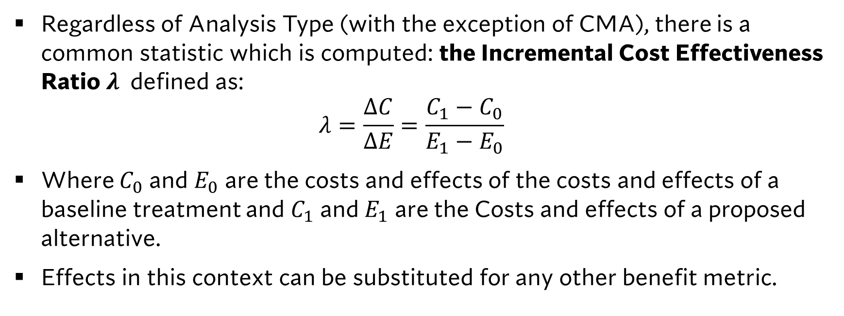
The ICER
Regardless of Analysis Type (with the exception of CMA), there is a common statistic which is computed: the Incremental Cost Effectiveness Ratio $λ$ defined as:
$λ=\frac{ΔC}{ΔE}=\frac{C_{1}−C_{0}}{E_{1}−E_{0}}$
Where $C_{0}$ and $E_{0}$ are the costs and effects of the costs and effects of a baseline treatment and $C_{1}$ and $E_{1}$ are the Costs and effects of a proposed alternative.
Effects in this context can be substituted for any other benefit metric.

Slide 29

A “Model Free” Approach to Cost Effectiveness Analysis
Costs of A
Effects of A
Treatment A
(The Alternative)
$$λ^{A}=\frac{ΔC_{A}}{ΔE_{A}}=\frac{C_{A}−C_{B}}{E_{A}−E_{B}}$$
Treatment B
Baseline
Treatment
Costs of B
Effects of B

Slide 30
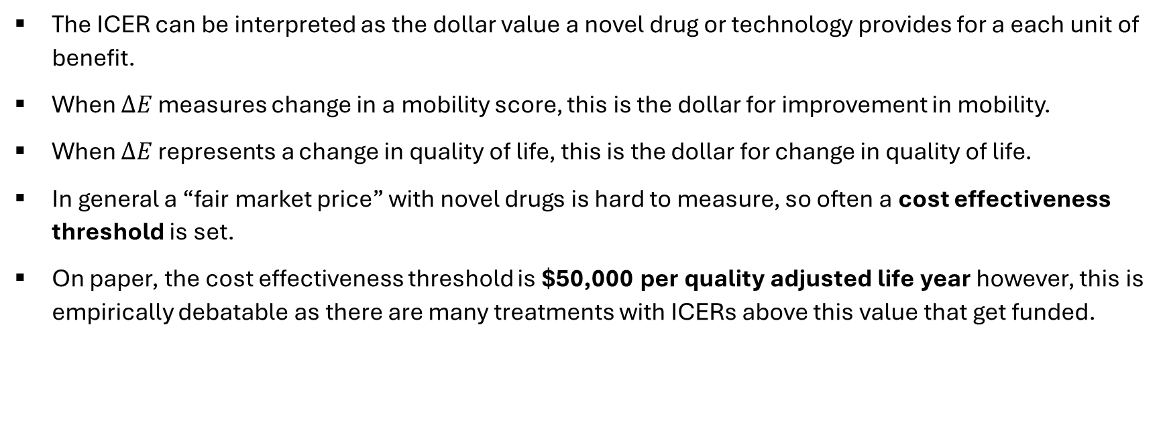
How to use the ICER
The ICER can be interpreted as the dollar value a novel drug or technology provides for a each unit of benefit.
When $ΔE$ measures change in a mobility score, this is the dollar for improvement in mobility.
When $ΔE$ represents a change in quality of life, this is the dollar for change in quality of life.
In general a “fair market price” with novel drugs is hard to measure, so often a cost effectiveness threshold is set.
On paper, the cost effectiveness threshold is $50,000 per quality adjusted life year however, this is empirically debatable as there are many treatments with ICERs above this value that get funded.

Slide 31
The Measurement of Benefits: Welfarism VS Extra Welfarism
The most controversy in this field methodologically lies in the definition of benefits and costs.
There are two normative approaches to economic evaluation.
  Welfarism: Only those who immediately benefit from the treatment matter, measurement such as care giver wellbeing, productivity or other measures overstate the benefits.
  Extrawelfarism: Benefits should consider all possible parties who benefit. (including individuals who are not the patient directly)
Part of this ideological split has led to new cost-effectiveness paradigms such as Distributional Cost Effectiveness Analysis (DEA), Extended Cost Effectiveness Analysis (ECEA), and Generalized Risk Adjusted Cost Effectiveness Analysis (GRACE).
The concepts of Welfarism VS Extrawelfarism is discussed in:
Brouwer, Werner BF, et al. "Welfarism vs. extra-welfarism." Journal of health economics 27.2 (2008)

Slide 32
The Cost Effectiveness Plane

Slide 33





The cost effectiveness plane and the ICER
$$ΔC$$
We will often plot each of our ICERS in a Cost Effectiveness Plane.
The vertical axis is the change in costs.
The horizontal axis is the change in effects.
This is a useful tool for visualizing our results and will help with building intuition as we progress through the course.
$$ΔC^{A}$$
$$λ^{A}=ΔC^{A}/ΔE^{A}$$
0
0
$$ΔE^{A}$$
$$ΔE$$

Slide 34





The cost effectiveness plane and the ICER
$$ΔC$$
We will speak about quadrants as first second, third or fourth.
Or we will speak of them as
North East (I), North West (II), South West (III) or South East.
$$II$$
$$I$$
0
0
$$ΔE$$
$$IV$$
$$III$$

Slide 35


The cost effectiveness plane and the ICER
$$ΔC$$
More Costly, Less Effective
(Never Cost Effective)
More Costly, More Effective
(Can be cost effective)
We can easily interpret an ICER in each of these quadrants.
Two important quadrants are the 2nd and 4th quadrant where regardless of threshold value a ICER will be cost effective or not.
Keep this picture in mind, as we will see it a couple times in the future.
0
Less Costly, Less Effective (Can be cost effective)
0
$$ΔE$$
Less Costly, More Effective
(Always Cost Effective)

Slide 36
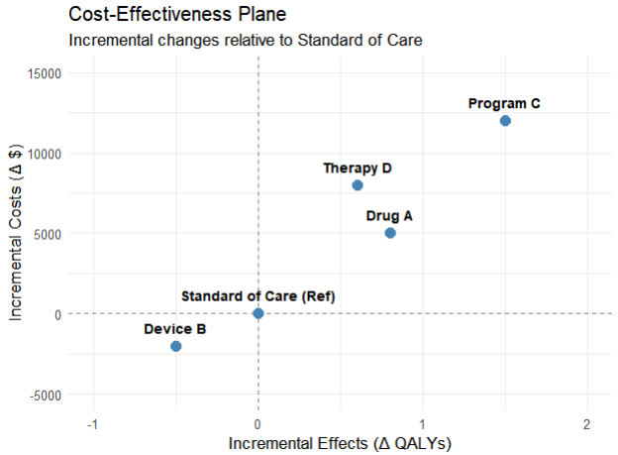
Intervention | Total Cost ($) | Total QALYs | Inc. Cost (ΔC) | Inc. Effect (ΔE) | ICER ($/QALY)
Standard of Care (Ref) | $10,000 | 5.0 | $0 | 0.0 | —
Drug A | $15,000 | 5.8 | +$5,000 | +0.8 | $6,250
Device B | $8,000 | 4.5 | -$2,000 | -0.5 | $4,000
Program C | $22,000 | 6.5 | +$12,000 | +1.5 | $8,000
Therapy D | $18,000 | 5.6 | +$8,000 | +0.6 | $13,333

Slide 37
Simple and Extended Dominance

Slide 38


What is Simple Dominance?
A dominant treatment is one which is more effective and less costly.
In the CE plane it lies in the 4th Quadrant.
This is referred to as Simple Dominance.
This is a solution concept tied to comparison of a single alternative to
a base case. What if we have multiple alternatives? We need a new concept known as Extended Dominance.
$$ΔC$$
$$ΔE$$
Here

Slide 39
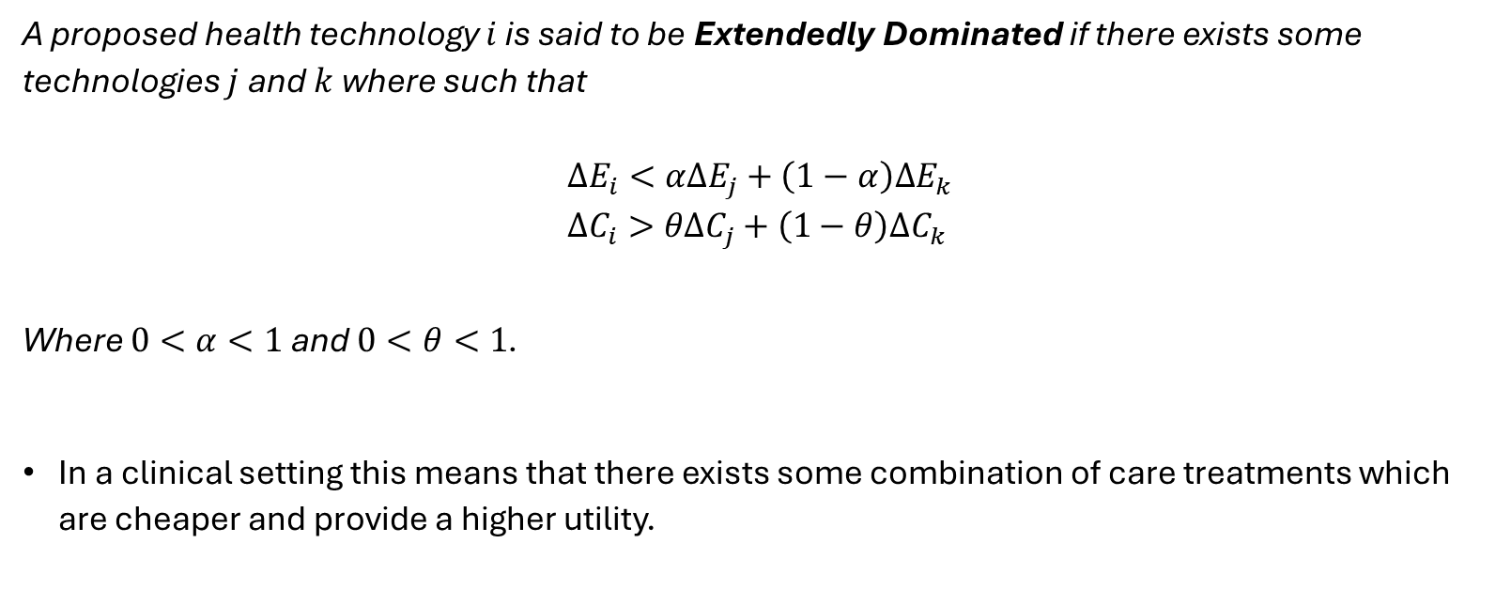
A Definition of Extended Dominance
A proposed health technology $i$ is said to be Extendedly Dominated if there exists some technologies $j$ and $k$ where such that
$$ΔE_{i}<αΔE_{j}+\left(1−α\right)ΔE_{k} \\ ΔC_{i}>θΔC_{j}+\left(1−θ\right)ΔC_{k}$$
Where $0<α<1$ and $0<θ<1$.
In a clinical setting this means that there exists some combination of care treatments which are cheaper and provide a higher utility.

Slide 40
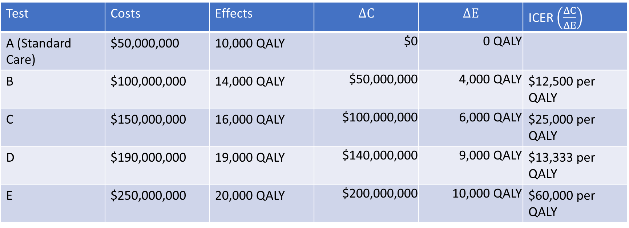
Example
Test | Costs | Effects | $$ΔC$$ | $$ΔE$$ | ICER $\left(\frac{ΔC}{ΔE}\right)$
A (Standard Care) | $50,000,000 | 10,000 QALY | $0 | 0 QALY
B | $100,000,000 | 14,000 QALY | $50,000,000 | 4,000 QALY | $12,500 per QALY
C | $150,000,000 | 16,000 QALY | $100,000,000 | 6,000 QALY | $25,000 per QALY
D | $190,000,000 | 19,000 QALY | $140,000,000 | 9,000 QALY | $13,333 per QALY
E | $250,000,000 | 20,000 QALY | $200,000,000 | 10,000 QALY | $60,000 per QALY
Table based on Cost Effectiveness Modelling for Health Technology Assessment: A Practical Course, Eldin et.al

Slide 41







$$ΔC$$
$$E$$
$$D$$
$$C$$
$$B$$
$$A$$
$$ΔE$$

Slide 42





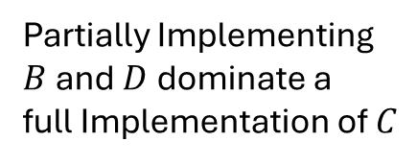


$$ΔC$$
$$E$$
Partially Implementing
$B$ and $D$ dominate a
full Implementation of $C$
$$D$$
$$C$$
$$B$$
$$A$$
$$ΔE$$

Slide 43






$$ΔC$$
No Dominated alternatives.
$$E$$
$$D$$
$$B$$
$$A$$
$$ΔE$$

Slide 44
Summary
In this lecture we discussed:
  What Economic Evaluation is and the Concepts from Economics Which we draw on.
  An Overview of Analysis Types.
  The ICER and Cost Effectiveness Plane
  The concept of Simple VS Extended Dominance in Cost Effectiveness Analysis.
In our next lecture wee will discuss how cost effectiveness analyses are situated in the broarder health sciences literature and discuss different approaches to measuring costs, effects and discounting them into the future.

